Slide 1
Practice Session 1
Exploring our Aspirations and Concerns
Document prepared by UHV Team (uhv.or.in) and adopted by AICTE NCC-IP Sub-committee for Mentor Manual and related Materials for UHV-I
Suggestions for improvement are welcome
All Rights Reserved

Slide 2
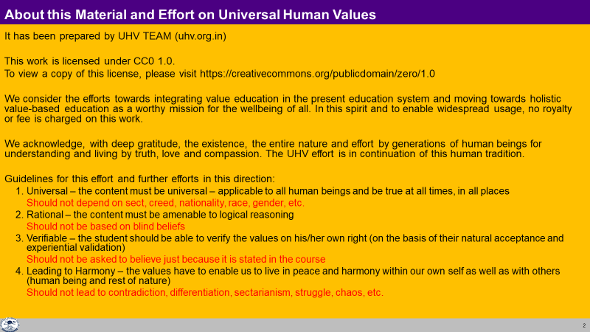

Slide 3
Home Assignment Review
You must have completed your home assignment:
  Make a list of your aspirations* (चाहना)
  Make a list of your achievements (उपलब्धि) in your life
  Make a list of your concerns (चिंता),confusions (भ्रम) and questions (जिज्ञासा)
Let us get some of the points from these lists on the board
* You may like to include the expectations (अपेक्षा) of your family and friends
  as well as the hopes (आशा) the nation has from you

Slide 4
Your Aspirations, Concerns and Achievements
Aspirations | Achievements | Concerns
To do well in college | Came first in my class | Tension, peer pressure
Happiness in the family |  | Anger, not much time for family

Slide 5
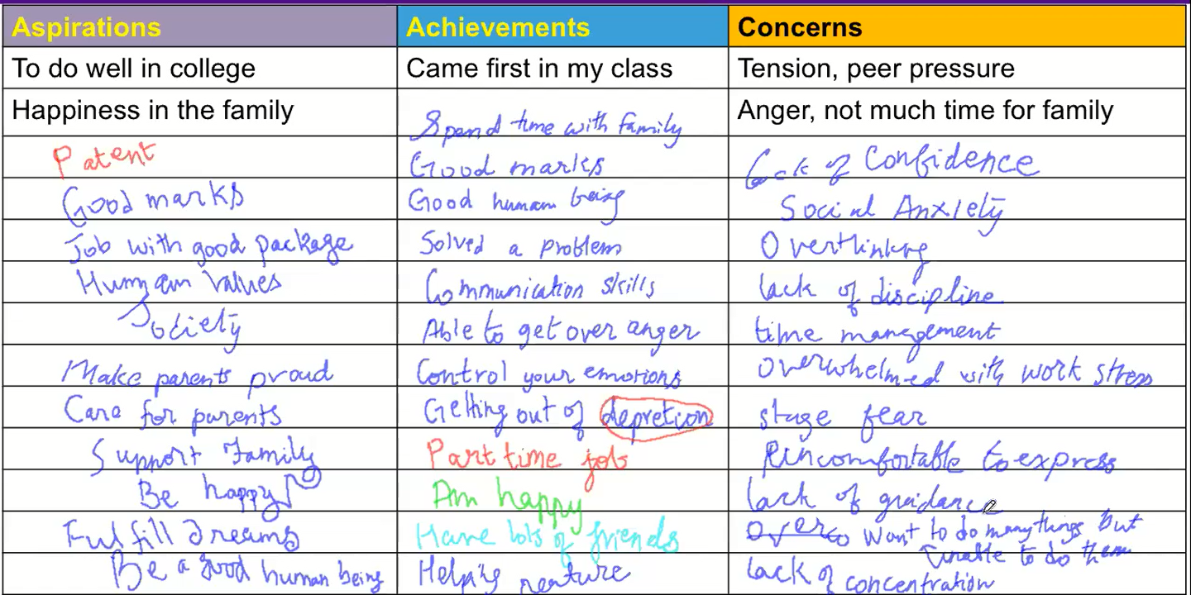
Your Aspirations, Concerns and Achievements (from 26 Jan 2022 eSIP Followup Session)

Slide 6

Effort
We are all making tremendous effort!
Is your effort (प्रयास)
  To fulfil your aspirations (चाहना)?
  Or
  To resolve your concerns (चिंता),confusions (भ्रम) and questions (जिज्ञासा)?
  Or
  For something else?
Make a list of all the effort that you are making
Also note down why you are making that effort
What is your basic aspiration?
Examples:
  I am studying hard… so that I get a degree… so that…
  I do what my mother wants… to express my respect to her… so that…
  I am saving my pocket money… to buy a mobile for my brother… so that…
  I am playing video games… so that…
We will explore this further

Slide 7
Aspiration
Effort…
to Become Something?
an engineer
a doctor
a farmer
an artist
a teacher
to Do Something?
Build bridges…
Keep people healthy…
Grow nutritious food…
Inspire through music…
Educate…
to Get Something?
Money, name, respect…
Fame, money…
Acceptance, respect, money…
Name, fame, money…
Money, respect…
to Be Something?
every moment?
Happy, prosperous
Happy, prosperous
Happy, prosperous
Happy, prosperous
Happy, prosperous
---------------------These are the steps, pathways to reach to the goal--------------------
Goal, basic aspiration
Which is your goal, your basic aspiration?
Then, what are these other things?
Would you like to make sure that the steps definitely add up to happiness and prosperity?

Slide 8
Aspiration
Effort
To fulfil your basic aspiration, how would you like to plan your life?
  Start with hard work, to become something…? (effort, steps at the base)?
  Make effort for understanding happiness and prosperity (your basic aspiration) and then choose a comprehensive pathway? (based on clarity about basic aspiration)?
How are you going about your life?
Check if you have become happier year after year (say in last 10 years)
to Become Something?
to Do Something?
to Get Something?
to Be Something?
every moment?
Happy, prosperous
Plan with effort, steps at the base
Understand happiness and prosperity, plan with that clarity and make effort
---------------------These are the steps, pathways to reach to the goal--------------------
Goal, basic aspiration

Slide 9
Aspiration
Effort
Now that we can distinguish between basic aspiration and the steps to fulfill it, find out
what would be appropriate if your “favourite” pathway is closed:
  Be unhappy, get depressed, become inactive?
  Find an alternate pathway?
Examples:
  I wanted to go to the US for my degree, but I was forced to take admission here by my parents. My dreams are shattered
  I did not get the branch of my choice. My motivation to study is gone
  I did not get the room mate I wanted. I am unhappy
to Become Something?
an engineer
a doctor
a farmer
an artist
a teacher
to Do Something?
Build bridges…
Keep people healthy…
Grow nutritious food…
Inspire through music…
Educate…
to Get Something?
Money, name, respect…
Fame, money…
Acceptance, respect, money…
Name, fame, money…
Money, respect…
to Be Something?
every moment?
Happy, prosperous
Happy, prosperous
Happy, prosperous
Happy, prosperous
Happy, prosperous
---------------------These are the steps, pathways to reach to the goal--------------------
Goal, basic aspiration

Slide 10
Aspiration
Effort
UHV is intended to help us to explore and
  1. Understand our basic aspirations (continuous happiness and prosperity)
  2. Verify, refine a comprehensive program to fulfil our basic aspirations
to Become Something?
an engineer
a doctor
a farmer
an artist
a teacher
to Do Something?
Build bridges…
Keep people healthy…
Grow nutritious food…
Inspire through music…
Educate…
to Get Something?
Money, name, respect…
Fame, money…
Acceptance, respect, money…
Name, fame, money…
Money, respect…
to Be Something?
every moment?
Happy, prosperous
Happy, prosperous
Happy, prosperous
Happy, prosperous
Happy, prosperous
Understand happiness and prosperity, plan with that clarity and make effort
---------------------These are the steps, pathways to reach to the goal--------------------
Goal, basic aspiration

Slide 11

Why is it important to understand the aspirations?
We will make effort in the intended direction (however far the destination may be)
We will know when we get there
Without clarity:
    we may get busy with “how to” and waver from the intended aspiration
    We may over-evaluate “our part” of the whole, get so involved in it that the overall target may be compromised
Whatever we feel, think, do, get done… should it not result in desired results?
So, we have to be clear about these desired results
Without that clarity, our efforts may be directionless!
with due apologies to our good doctors

Slide 12
Home Assignment

Slide 13
Home Assignment
Make a list of your aspirations (goals) and concerns (problems)
Mark what is required to fulfil each aspiration
Mark what is required to address each concern
To be written in your UHV-I Notebook
Aspiration or Concern | Fulfilled by Right understanding | Fulfilled by Fulfilment in relationship | Fulfilled by Physical facility
Good health | Yes (how to be healthy) | ? | Yes (food etc.)
Lasting friendships | ? | Yes | ?
Lots of money | ? | ? | Yes

Slide 14
Further Discussion

Slide 15
Life without Clarity of Basic Aspiration
If the basic aspiration (where you want to reach and stay there) is not clear, then it is likely that:
The direction of your effort may keep changing (as assumptions change)
You may not know if you have arrived or not
Very likely that there will be a mix of satisfaction and dis-satisfaction (appiness and unhappiness)
Present effort
The Basic Aspiration (Goal)
is not clear or it is vague, like:
Aim for the sky
Make money and have fun
…
Expect to become something
???
Expect to get/do something

Slide 16
Life with Clarity of Basic Aspiration (Goal)
(1) Our basic aspiration (human goal) is very clear – the destination is fixed
(2) We know our current state (right evaluation)
(3) We plan steps that connect and lead to
the fulfillment of basic aspiration
– direction is definite
Our basic aspiration is definite
It does not keep changing
(It seems to be the same
for all human beings)
(1)-Basic Aspiration
Fulfilling life
To BE always
happy and
prosperous
(निरंतर सुख)
Thinking, doing something
Expect to become something
Expect to get/do something
(3)-Direction of effort →
(2)-Current State
(कभी ख़ुशी, कभी ग़म)

